Slide 1
Product Leadership Games

Slide 2
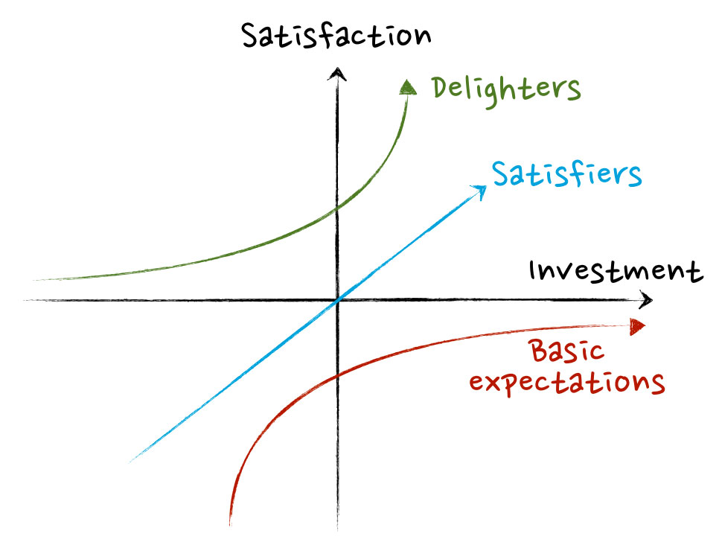
eXponential
Revenue
Kano: Delighters become Basic Expectations
Notes:
What happened with “statement”?

Slide 3
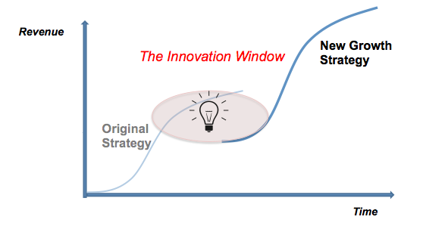
eXponential
So all growth strategies
are S-curves.
Growth is about the rate of ROI.
Notes:
What happened with “statement”?

Slide 4
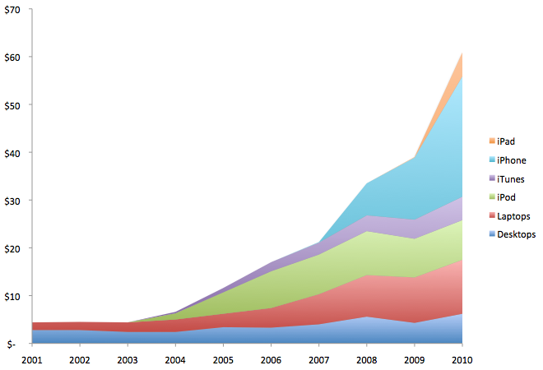
eXponential
Jobs: you go exponential by stacking S-curves.
Notes:
What happened with “statement”?

Slide 5
Maria Jean’s
Cannabis Café …
Potluck Pub …
Hash House A-Go-Go!
Which Epics will meet and obsolete the market?
Impact Mapping …

Slide 6
Why (our business drivers) | Convert illicit user base into paying customers | Subvert market for alcohol products | Subvert market for caffeine products
Who (market segments) | Pubs, Clubs, Bottle Shops | Cafes & Restaurants | Students & Surfers
How (our customers behaviour changes) | Use cannabis in commercial coffee brewing machines | Gamify & crowd-source production of better plant variants | Stock pre-mixed cannabis-based beverages
What (we supply) | Seeds & Starter Kits | Pre-packaged equivalents to traditional drinks | Powdered leaf suitable for steam extraction.
Which Epics will meet and obsolete the market?
Impact Mapping …

Slide 7
Why (our business drivers) |  | Subvert market for alcohol products
Who (market segments) | Pubs, Clubs, Bottle Shops
How (our customers behaviour changes) |  |  | Stock cannabis-based beverages
What (we supply) |  | Pre-packaged equivalents to traditional beverages
Rate of ROI
Acquisition
Activation
Retention
Recommendation
Revenue
Pirate
Metrics
Behavior Mapping
Which Epics will meet and obsolete the market?
Impact Mapping …

Slide 8
Simple design: adding value by removing that without.

Slide 9
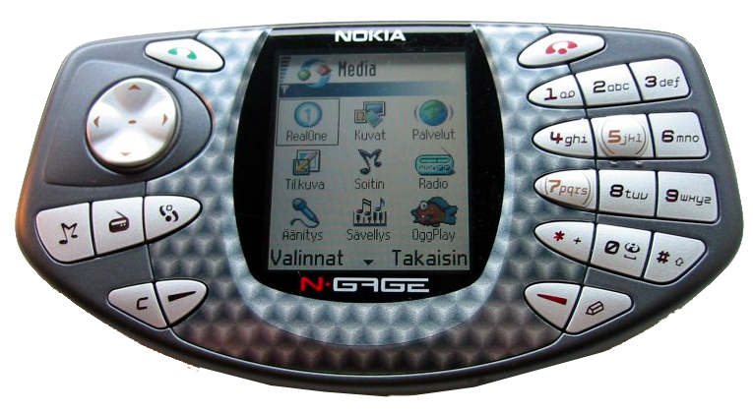
Simple
2004 Nokia N-Gage. Did everything iPhone did …
3 years before iPhone. Sank like a stone.

Slide 10
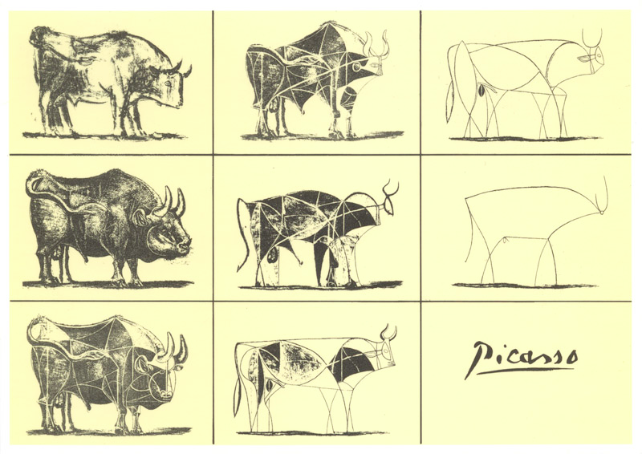
Simple
“Design means the elegance of minimum.
It isn’t look and feel. It’s how it works.” -- Jobs

Slide 11

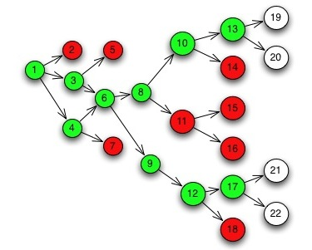
Simple
Simplicity comes breadth-first.
Set Based Design. Merciless Refactoring.

Slide 12
Maria Jean’s
Hash House A-Go-Go
How do we discover solution constraints we’ve missed or misunderstood?
Set Based Design

Slide 13
Design the logo for Maria-Jean’s.
2-Minute Design Sprint!
Acceptance Criteria!
Winnow!
Refactor!
Repeat!
How do we discover solution constraints we’ve missed or misunderstood?
Set Based Design

Slide 14
Autonomous self-control at all scales
for all functions.

Slide 15
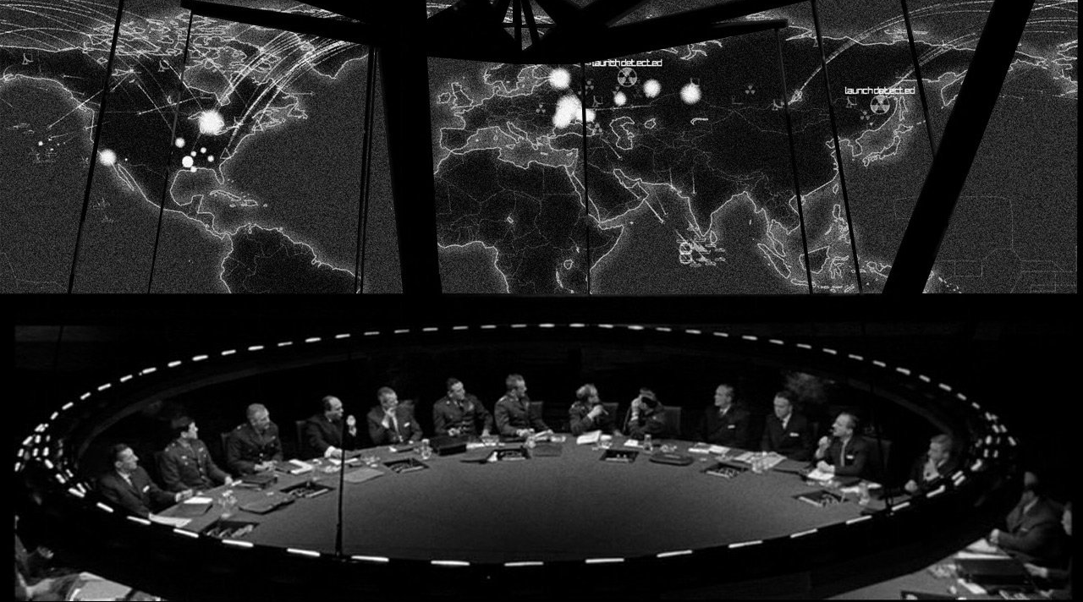
Autonomous
Command isn’t Control
No plan survives contact with the enemy.
-- Von Moltke.
Notes:
What happened with “statement”?

Slide 16
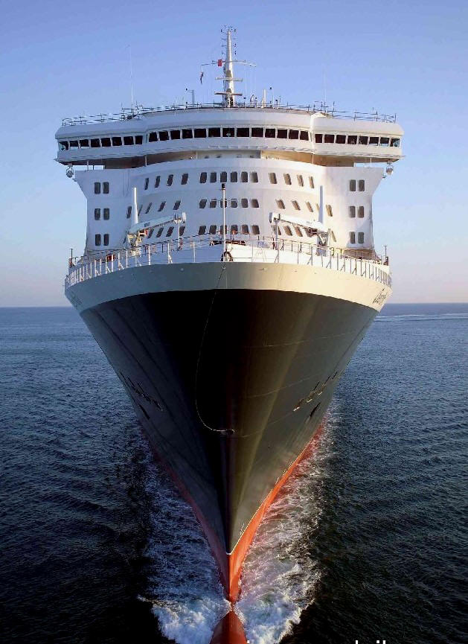
Autonomous
Systems are only in control when they
control themselves.
Don’t lead a great ship
like a jade figurehead.
Steady it as a stone keel.
-- Lao Tzu, 500 BC.
Notes:
What happened with “statement”?

Slide 17
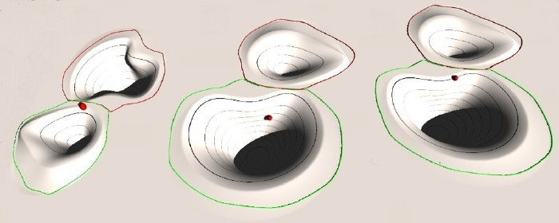
Autonomous
Unhappy
Paths
Customer
Happy
Paths
A keel is a Feature that controls system behavior.
The keel keeps the ship’s behaviors green.
Notes:
The relationship between process, team structure, and value stream function.
Processes
Impact Mapping
Acceptability Matrix
Backlog Bingo
Release Refactoring
Story Mapping
Scrumban
BDD
CD
Structure
Strategic Execution
Strategy Mapping

Slide 18
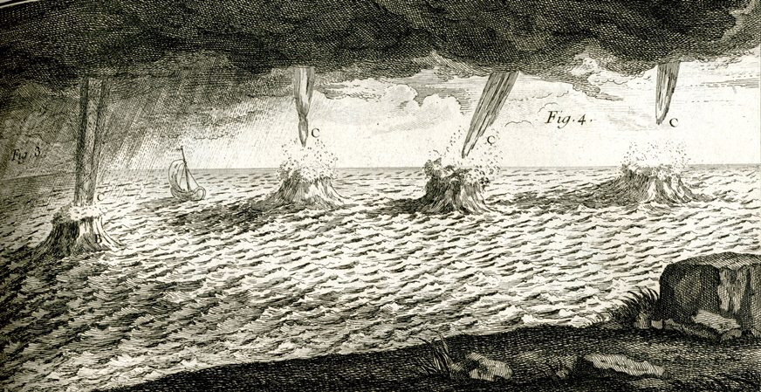
Autonomous
Don’t just think of unhappy paths as defects.
They’re where customers exit the UX before revenue.
Notes:
The relationship between process, team structure, and value stream function.
Processes
Impact Mapping
Acceptability Matrix
Backlog Bingo
Release Refactoring
Story Mapping
Scrumban
BDD
CD
Structure
Strategic Execution
Strategy Mapping

Slide 19
Maria Jean’s
Hash House A-Go-Go
How to align Design, Business and Technical decisions?
Behaviour Mapping

Slide 20
Category of Acceptance Criteria Personas from UXD Components from Architecture Non-Functional Numbers Business Rules | Barista (persona) | Dehydrator (component) | %THC (non-functional) | Don’t serve Intoxicated (business rule)
Green Beer As a pub patron I want green beer So I can be merry
Dope Fertilizer As a surfer dude I want dope fertilizer So I can grow strong buds
Powdered Leaf As a café I want powdered leaf So I can pull green espresso
Themes
Features
How to align Design, Business and Technical decisions?
Behaviour Mapping

Slide 21
Continuous adaptation of
teams to products to markets.

Slide 22
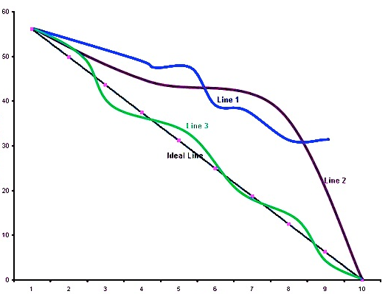
Continuous
Same Gantt Chart.
Different Behavior.
Flow rates matter.
Notes:
What happened with “statement”?

Slide 23
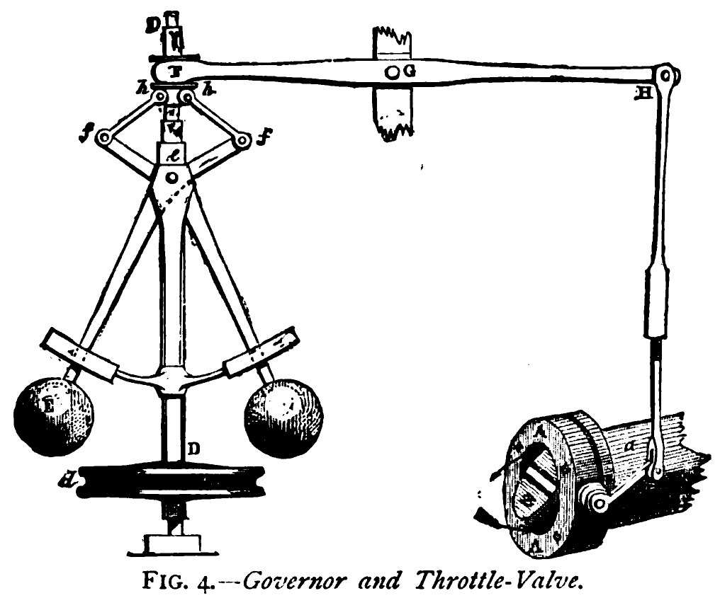
Continuous
Physical machines
use metric feedback
to control flow.
Notes:
What happened with “statement”?

Slide 24
Continuous
Released Features
Integrated Features
Implemented Stories
Velocity x Story Points
BDD-Covered Features
Feature Point Budgets
Product/Epic Investment
Product/Epic Return
Time
What are our metrics?
Notes:
What happened with “statement”?

Slide 25
Maria Jean’s
Hash House A-Go-Go
How do we know Sprint planning won't break Release planning?
Business Bingo

Slide 26
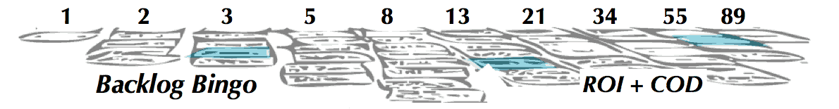
BV: 1
FP: 3
BV: 55
FP: 13
BV: 21
FP: 55
Cooking Green
Eggs & Ham
Coffee Bean
Grinding
Cultivating
Dope Yogurt
ROI: -0.7
ROI: 5.9
ROI: 0
Leaf Powdering
Manure Manufacture
ROI: ?
Green Beer Brewing
ROI: ?
ROI: ?
How do we know Sprint planning won't break Release planning?
Business Bingo

Slide 27
Triple Loop Learning

Slide 28
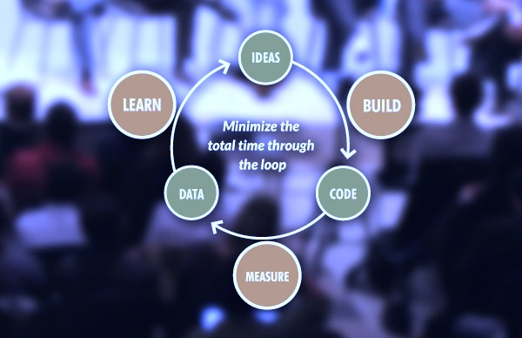
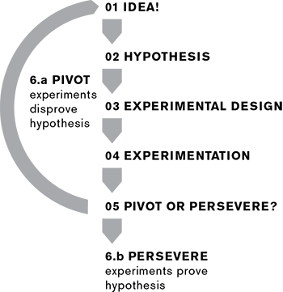
Learning
LEARN
BUILD
MEASURE
Lean Startup: single-loop learning. Startups don’t
know what they’re doing. They learn fast or die slow.
Notes:
What happened with “statement”?

Slide 29
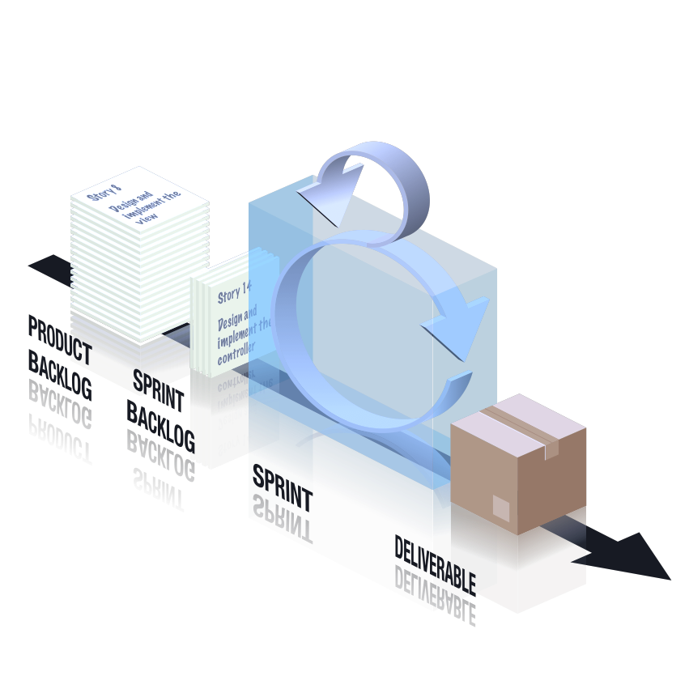
Learning
RETROSPECTIVE
Scrum is double-loop Learning.
Learning to optimize what you do and how.
Notes:
What happened with “statement”?

Slide 30
Learning
Portfolio
Squad
Why, Who & When.
Product
Squads
What teams deliver.
Chapter
Meetings
How teams deliver.
Continuously adapting teams to products to markets.
Triple loop learning
Notes:
What happened with “statement”?

Slide 31
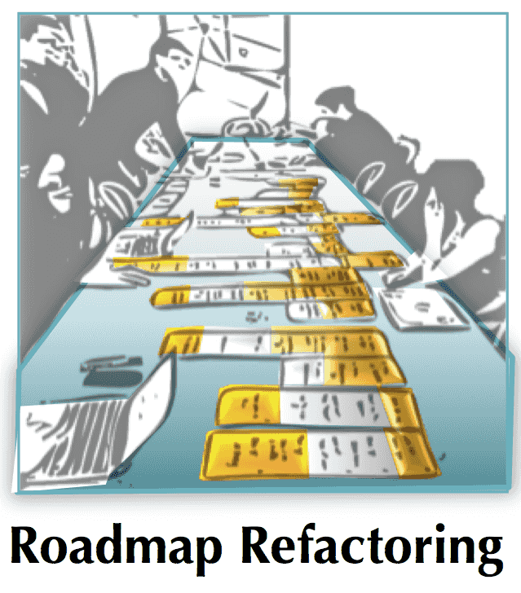
Maria Jean’s
Hash House A-Go-Go
How do we predict which features will be ready to ship by a what date?
Release Refactoring

Slide 32
Seeds & Starter Kits | Pre-packaged equivalents to traditional drinks | Powdered leaf suitable for steam extraction.
Epics
ROI: 9
FP: 8
ROI: 5.9
FP: 13
ROI: 9
FP: 5
ROI: 5.9
FP: 13
Leaf
Powdering
ROI: 14
FP: 11
ROI: 5
FP: 3
ROI: 3
FP: 8
ROI: 7.2
FP: 3
ROI: 15.
FP: 11
Dope Manure Manufacture
ROI: 5
FP: 16
ROI: 1.7
FP: 21
ROI: 1.7
FP: 21
ROI: 2
FP: 8
ROI: -0.7
FP: 3
Green Beer Brewing
ROI: -0.7
FP: 5
ROI: -2
FP: 5
ROI: -2
FP: 5
ROI: -6
FP: 3
ROI: -3
FP: 8
ROI: -6.7
FP: 6
ROI: -2.3
FP: 3
ROI: -0.7
FP: 3
How do we predict which features will be ready to ship by a what date?
Release Refactoring

Slide 33
Ecosystems aren’t big. They’re small.

Slide 34
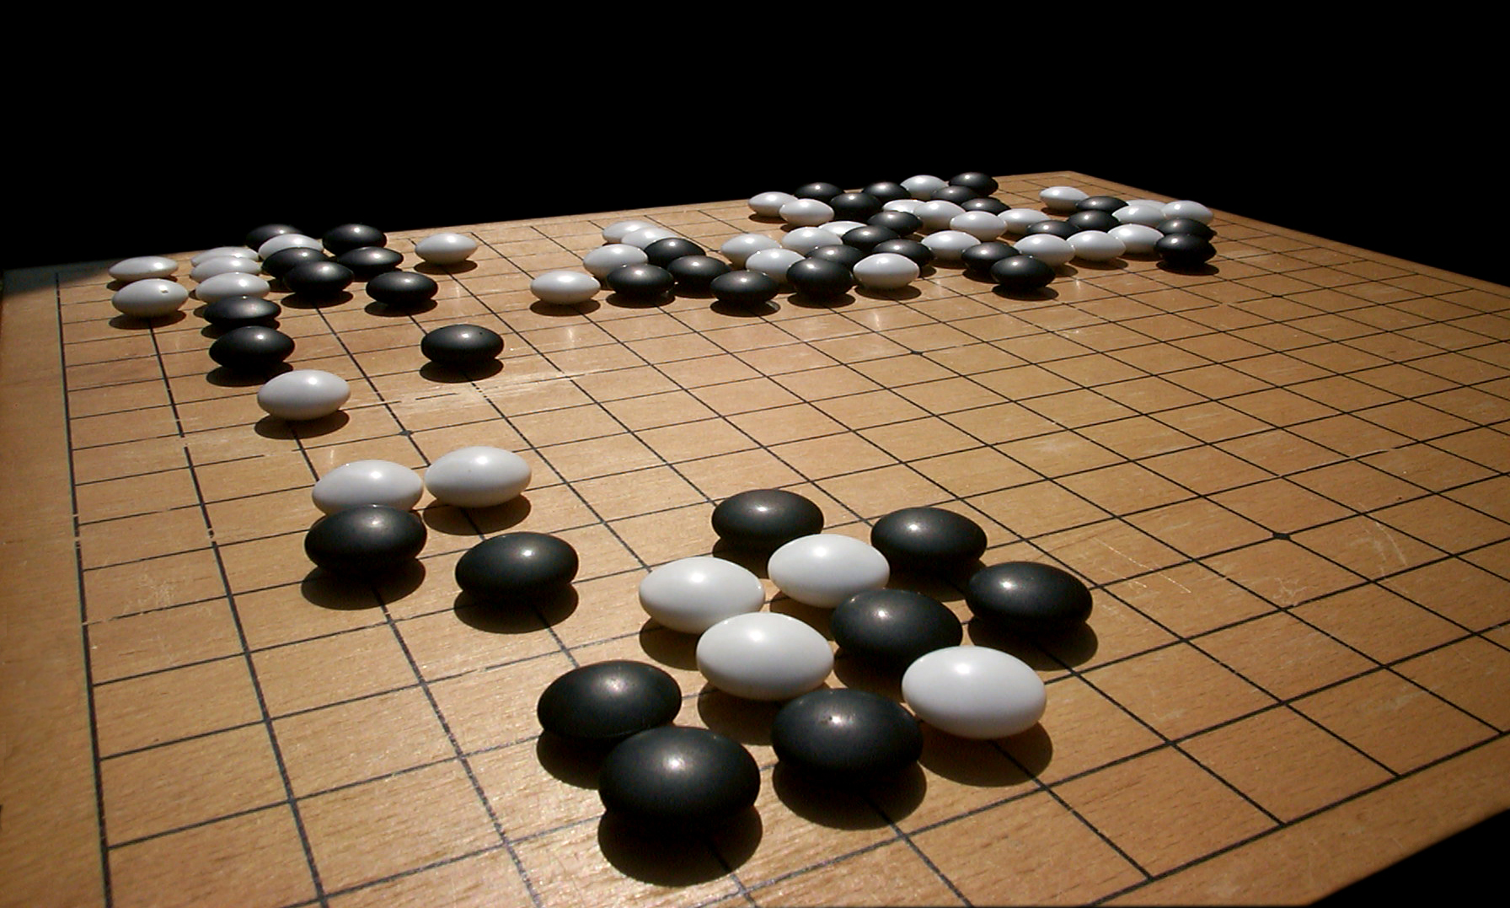
Ecosystem
Ecosystems are games that adapt the whole to its parts.
The game of Go calls this
“whole board thinking”.
For every move, start by thinking about the whole board. Then focus.
A breadth-first, iterative and contractive discipline.
We do this per move, not per game. It rewards adaptation, not force.
Notes:
What happened with “statement”?

Slide 35
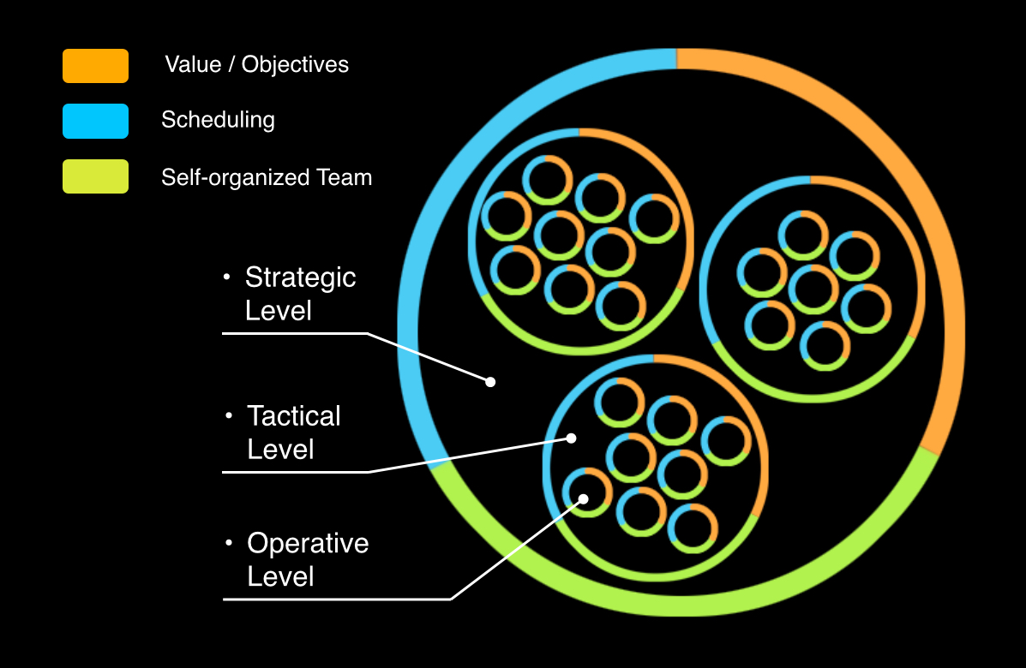
Ecosystem
Build
Measure
Learn
Portfolio
Product
Squad
Ecosystem-thinking: every team thinks whole-board.
Notes:
What happened with “statement”?

Slide 36
Context
Chapter Leaders
Squad: 2 - 10 people
Chapter: 4 - 20 people
Portfolio: 10 - 100 people
Stakeholders
Lean Product Squads
Business SMEs
Customer Reps
Delivery SMEs
Product Leaders & Coaches
Portfolio Leader
Portfolio Coach
Business & Technology Guilds
Analysts
Portfolio Squad
Testers
Leadership Guild
Agile Delivery Squads
Designers
Coaching Guild
Developers
Transformation Leader & Coach
Technology Leaders & Coaches
Quality Automation
DevOps Squads
Process Automation
Production Support
…
© Peter Merel, 2016
Portfolio 2
Portfolio 3
What does an XSCALE organization really look like?
“It’s only a model”
Notes:
What happened with “statement”?

Slide 37
3rd Generation Agile
For Exponential Growth
Peter Merel http://xscale.wiki

